Slide 1
Title : Global Economic and Demographic Trends Analysis
Name: Anupriya.C

Slide 2
Over View
This Data Contains :
GDP by Country(1960-2016) Excel file
Meta Country CSV File
Population Per Country CSV file
Countries World SQL file

Slide 3
ObJective
This report provides an analysis of global economic and demographic trends using key indicators such as GDP per capita, population density, literacy rate, infant mortality, and other economic factors.
This analysis serves as a decision-making tool for policymakers, researchers, and analysts, helping to identify disparities, forecast trends, and plan for sustainable economic and social development.

Slide 4
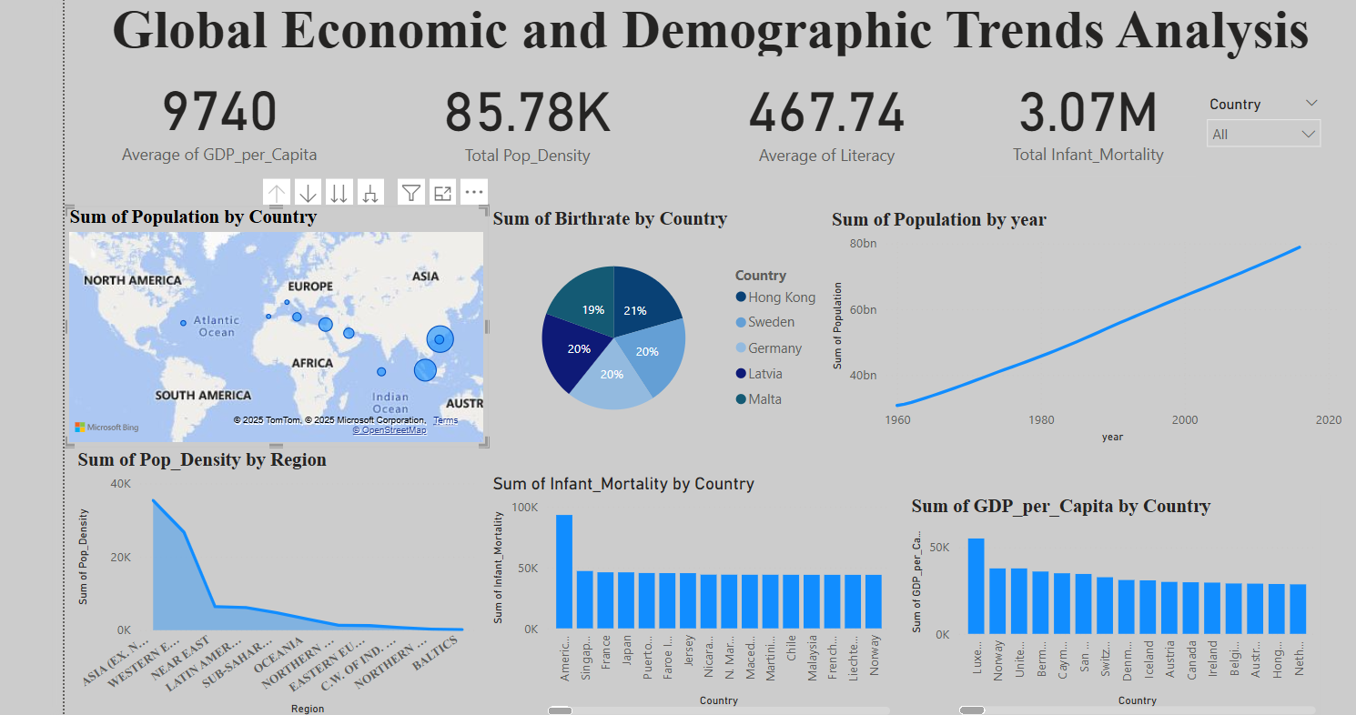
Dash bOARD

Slide 5
INSIGHTS
The Highest GDP has Luxembourgh, Norway
The Lowest GDP has Western Sahara
The High Pop Density Region wise is Asia
The Low Pop Density Region wise Sub Saharan Africa
Hong Kong has highest Birth rate
Malta has lowest Birth rate

Slide 6
Conclusion
Literacy : Investment in Education & Healthcare
Population Growth: it leads to Poor air, and water Quality, Waste Disposal Problems,
And high energy consumption
Health Care Improvements: Regions with High infant Mortality rates require better
Health Care Access, prenatal Care, and disease prevention programs
Address Urbanization Challenges: Policies should focus on sustainable city planning, improved public transportation, and job opportunities to manage high population densities.
Future Economic Growth Potential: Countries with lower GDP can improve by investing in infrastructure, technology, and human capital development.

Slide 7
Final Thoughts:
The Global Economic and Demographic Trends Dashboard highlights significant variations in GDP, population, birthrates, literacy, and mortality rates across different regions.
The data suggests that while economic and social progress is evident in some areas, disparities persist between developed and developing nations.
Strategic policy interventions, education, healthcare reforms, and economic planning are critical for ensuring sustainable growth and improved living standards worldwide.
The Global Economic and Demographic Trends Analysis reveals strong economic performers and struggling nations, but it also presents an opportunity to address inequalities, invest in human capital, and drive sustainable development. Moving forward, collaborative efforts between governments, businesses, and global organizations will be essential in shaping a prosperous, inclusive, and sustainable future for all.

Slide 8


